Slide 1

Number Recognizer
JavaFX Application with TensorFlow Model
Amrita Dubey

Slide 2
Technology Used
JavaFX: Used for GUI implementation
Python and TensorFlow Keras: Train Sequential and CNN model
MNIST Datasets: The Dataset used is MNIST Dataset. It is a subset of a larger set available from NIST.
TensorFlow java library: Used for model integration
Maven: build automation and dependency management tool. Maven uses a project object model (POM) file to define the project structure and dependencies.

Slide 3
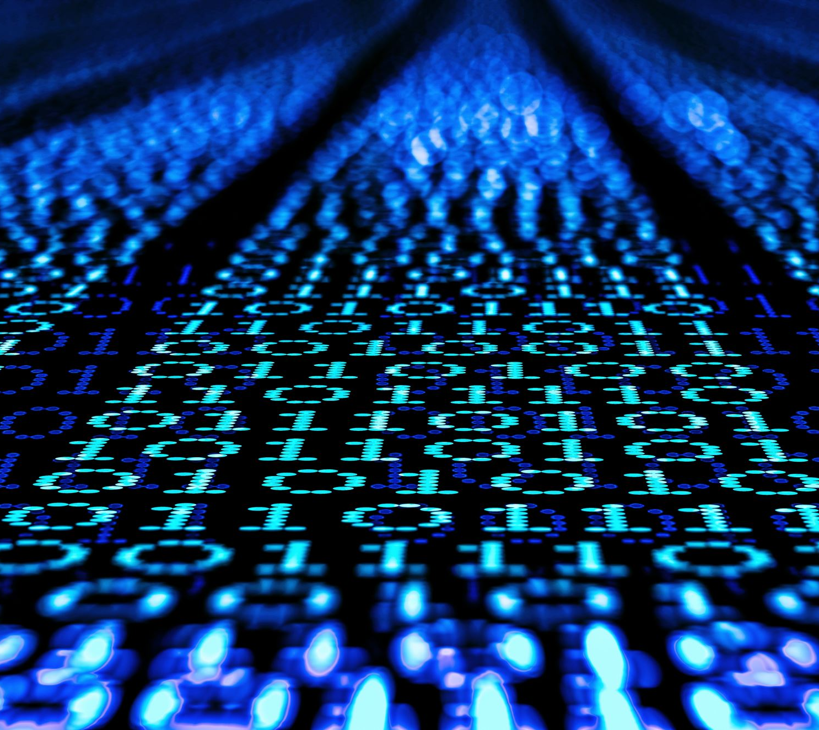
About MNIST Dataset
The MNIST dataset is a collection of handwritten digits that are commonly used as a benchmark for image classification tasks in machine learning
It consists of a training set of 60,000 examples and a test set of 10,000 examples, where each example is a 28x28 grayscale image of a handwritten digit and its corresponding label

Slide 4

TensorFlow Model
CNN Model
Convolutional Neural Network, which is a deep learning algorithm used for image processing and computer vision. It consists of multiple layers of convolutional filters and pooling layers, which are trained to identify features in images
Sequential Model
The model consists of a linear stack of layers where data flows sequentially through the layers.
The first layer, Flatten(), converts the input data into a 1-dimensional array to feed it into the next layer. Last layer is a Dense layer with 10 neurons and SoftMax activation function. The SoftMax converts the output into a probability distribution over the 10 classes, where the sum of all probabilities equals 1
Notes:
CNNs can automatically learn important features from images such as edges, curves, and textures by using convolutional layers. These layers apply a set of filters to the input image and extract features from it. CNNs are better suited for image recognition tasks because they can extract meaningful features from the input image and reduce its dimensionality, resulting in better performance than sequential models.

Slide 5
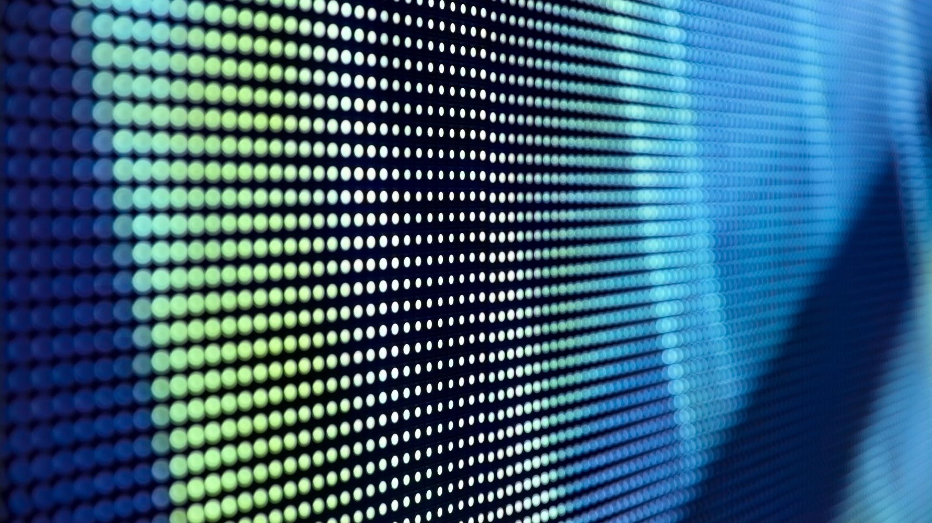
Image Pre Processing
To get better prediction accuracy, image preprocessing is required before feeding it to model.

Slide 6
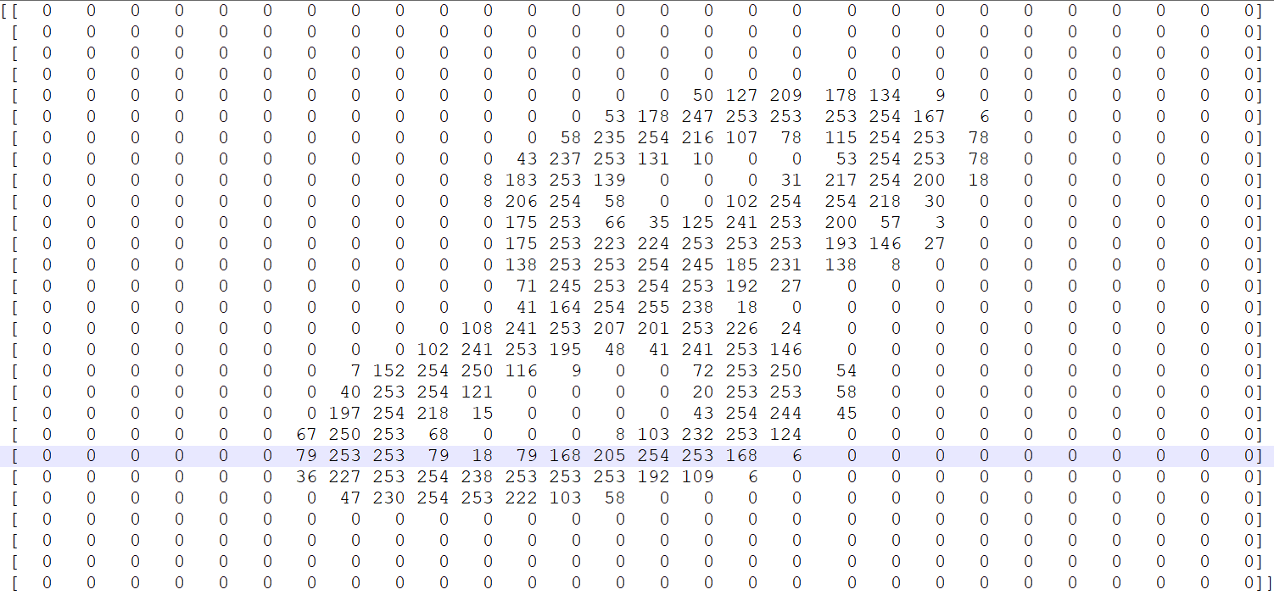
[28][28] Pixel Representation of 8

Slide 7
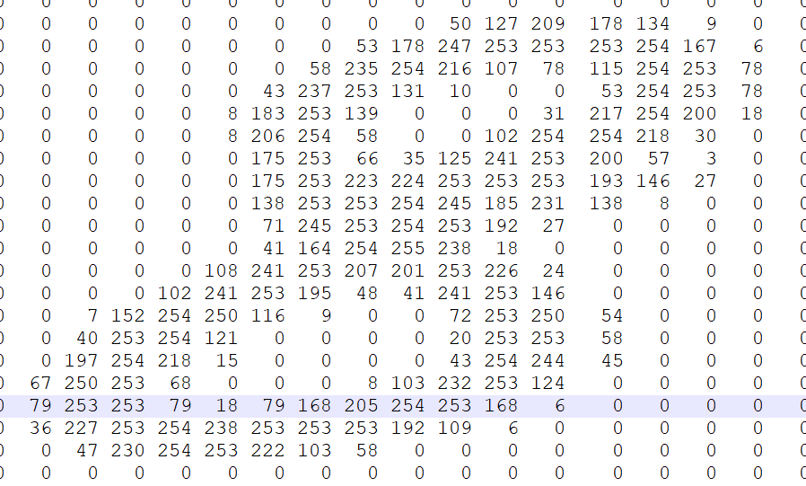
Center and re-scale

Slide 8
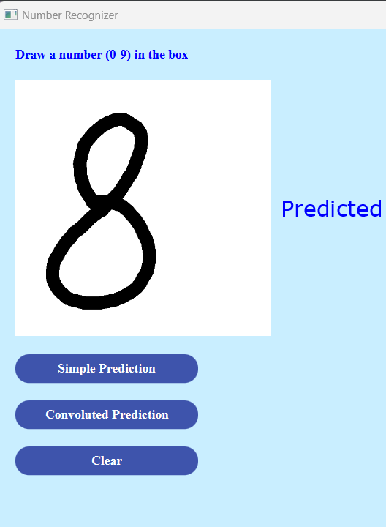
Steps to follow for number recognition
Add Canvas for writing numbers on screen
Convert canvas to image and 2D array
Image Preprocessing:
Get image width and height based on that get image boundary box
Re scale, center and resize the image
Get final 2D or 4D array according to model requirement
Load the TensorFlow models
Feed the model with processed image and get probabilities for 10 digits
Finally get the digit which has maximum probability

Slide 9
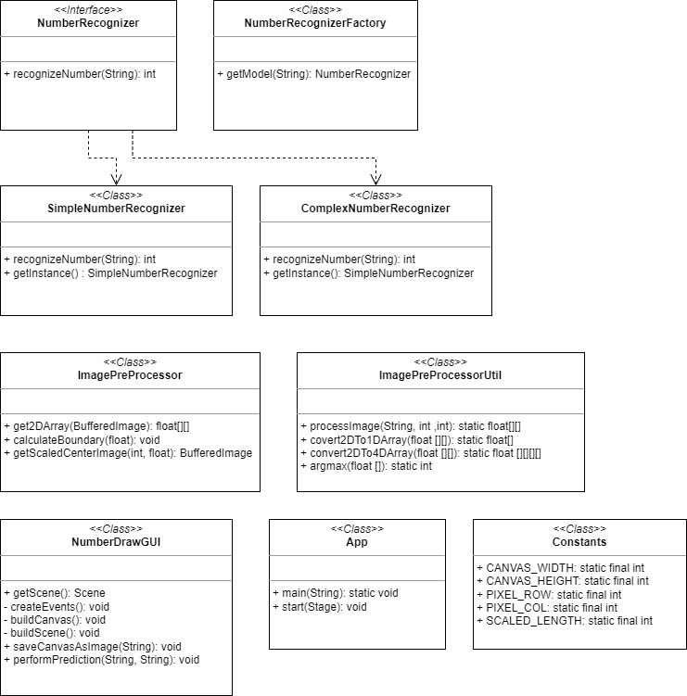
Class Diagram of Project

Slide 10

Thank You

